Slide 1
Nevada Department of Transportation Presentation to the Sagebrush Ecosystem Council
Chris Young, Chief, Environmental Services Program
July 31, 2024

Slide 2
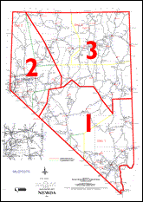
Nevada Department of Transportation (NDOT)
Highway Department was established in 1917. NDOT was created in 1979.
Centralized with headquarters in Carson City.
Divided into three geographical districts for administrative purposes, each with subdistricts.
District 1 Administration, Las Vegas
District 2 Administration, Sparks
District 3 Administration, Elko

Slide 3
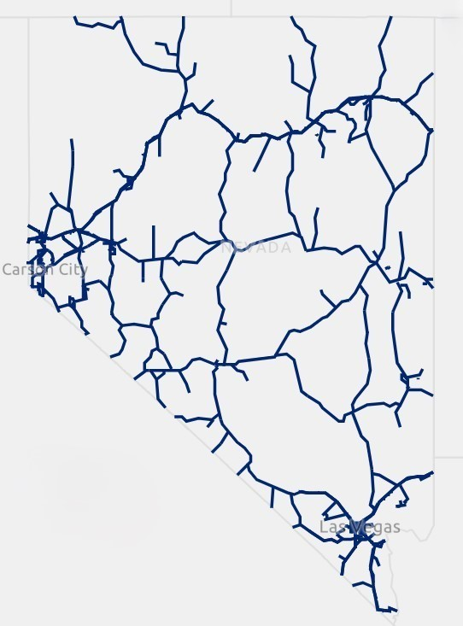
Nevada Department of Transportation (NDOT)
NDOT Administered Centerline Miles: 5,356
Interstates
US Highways
State Routes
Maintenance Sites: 81
Rest Areas: 33
Material Sites (pits): Approx. 1200
For informational purposes only and subject to revision

Slide 4
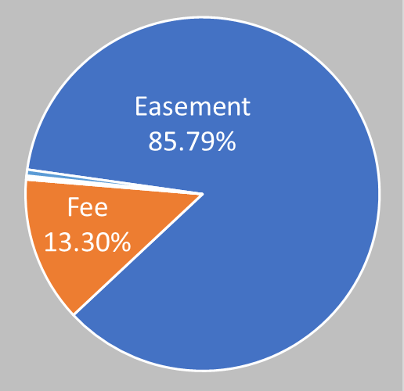
NDOT RIGHT-OF-WAY “OWNERSHIP”
Interest Area %
Fee 42.5 square miles 13.3%
Easement 273.8 square miles 85.8%
Prescriptive 1.74 square miles 0.55%
Per Agreement 0.70 square miles 0.22 %
Other 0.14 square miles 0.14%
318.88 square miles of right-of-way
For informational purposes only and subject to revision

Slide 5
NDOT RIGHT-OF-WAY
All right-of-way and material sites on federal lands are processed through the Federal Highway Administration (FHWA) and accomplished by a Highway Easement Deed processed through the FHWA in cooperation with the federal land managing agency.
In nearly all cases for federal easements used for “highway purposes”, NDOT activities within those rights-of-way (new construction and maintenance) require no further right-of-way related review, approval, or authorization by the federal landowner.
The federal landowner does have review and approval or authorization obligations when NDOT obtains new temporary or permanent rights to federal lands.

Slide 6
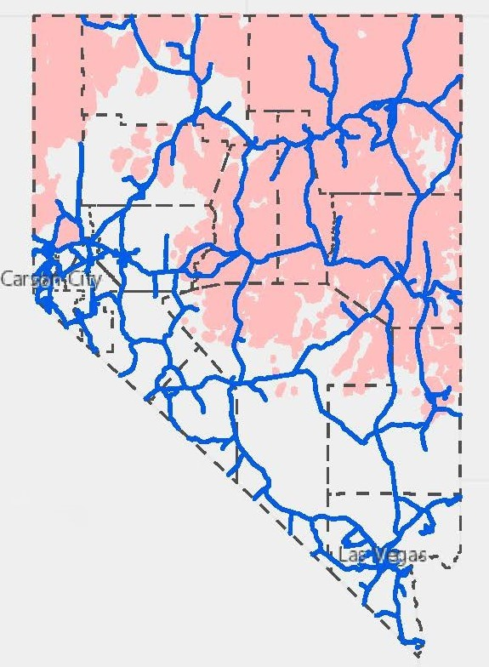
NDOT Highways and Greater Sage Grouse Habitat
1,694 centerline miles of NDOT roads are within Greater Sage Grouse habitat
128 square miles of NDOT administered right-of-way within Greater Sage Grouse Habitat
For informational purposes only and subject to revision

Slide 7
NDOT Environmental Division
In State Fiscal Year 2024, NDOT Environmental reviewed and cleared for delivery 64 federal-aid and State funded construction projects, 92 district construction contracts, 56 maintenance requests, 20 Recreational Trails Program projects, and performed more than 800 right-of-way occupancy and encroachment permit reviews.
NDOT Environmental has 5 biologists to cover the entire state.

Slide 8
NAC 232.460 Applicability. (NRS 232.162)
1. Except as otherwise provided in this section and to the extent it is not prohibited by federal law, the provisions of NAC 232.400 to 232.480, inclusive, apply to any person or entity that proposes an activity or project on public lands subject to state or federal review, approval or authorization, that will cause an anthropogenic disturbance.
2. The provisions of NAC 232.400 to 232.480, inclusive, do not apply to:
(a) A direct anthropogenic disturbance on private lands;
(b) An activity or project which was approved by all relevant federal agencies and state agencies before December 7, 2018, so long as the activity or project maintains compliance with any condition or requirement for any such approval;
(c) An activity or project using a mitigation agreement or framework agreement for greater sage-grouse signed by the United States Fish and Wildlife Service before December 7, 2018, and any amendments thereto;
(d) A mineral exploration project which is limited to a surface disturbance of not more than 5 acres;
(e) An activity or project that:
(1) Is necessary to protect public health or safety; or
(2) Will have a de minimis impact to greater sage-grouse and sagebrush ecosystems in this State; or
(f) Any emergency activity or routine administrative activity that:
(1) Is performed by a federal agency, state agency, local government or utility for a public purpose; and
(2) Does not require any additional approval from the Federal Government or the State.
(Added to NAC by Sagebrush Ecosystem Council by R024-19, eff. 10-30-2019)
Currently operating under Section 1
Up to March 2024 operating under provision 2(b)

Slide 9
Where NDOT is at Now?
Working with SETT to establish operational implementation of NDOT compliance with NAC 232.460/NRS 232.162 and participation in the Conservation Credit System either through an agency specific agreement or other instruments that will recognize the breadth and complexity of the NDOT program, make efficient use each agency’s staff, and ultimately benefit the Greater Sage Grouse in Nevada.

Slide 10
Thank You Chris Young Nevada Department of Transportation Chief, Environmental Services Program cyoung@dot.nv.gov 775.888.7687

